Slide 1
Characteristics of DC motors

Slide 2
Generally, three characteristic curves are considered important for DC motors which are,
(i) Torque vs. armature current,
(ii) Speed vs. armature current and
(iii) Speed vs. torque.
T_{a} ∝ ɸ.I_{a} and
N ∝ E_{b}/ɸ
For a DC motor, magnitude of the back emf is given by the same emf equation of a dc generator
i.e. E_{b} = PɸNZ / 60A.
For a machine, P, Z and A are constant, therefore, N ∝ E_{b}/ɸ

Slide 3
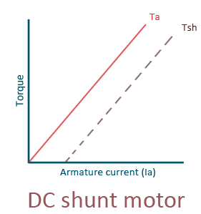
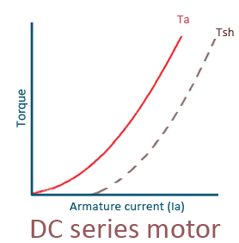
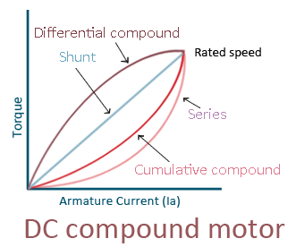
Characteristics of DC shunt motors Torque vs. armature current (Ta-Ia)
In case of DC shunt motors, we can assume the field flux ɸ to be constant. As we are neglecting the change in the flux ɸ, we can say that torque is proportional to armature current. Hence, the Ta-Ia characteristic for a dc shunt motor will be a straight line through the origin.

Slide 4
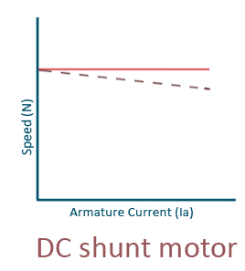
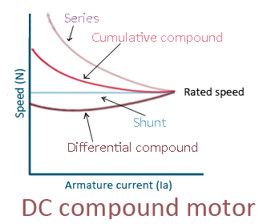
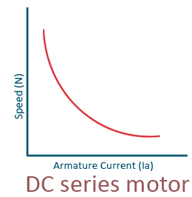
Speed vs. armature current (N-Ia)
As flux ɸ is assumed to be constant, we can say N ∝ Eb. But, as back emf is also almost constant, the speed should remain constant.
But practically, ɸ as well as Eb decreases with increase in load.
Back emf Eb decreases slightly more than ɸ, therefore, the speed decreases slightly. Generally, the speed decreases only by 5 to 15% of full load speed.

Slide 5
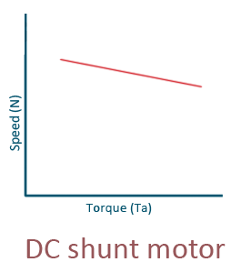
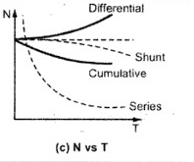
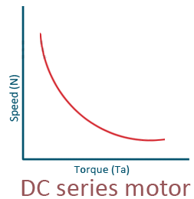
Speed vs. torque (N-Ta)
This characteristic is also called as mechanical characteristic.

